Slide 1
AS91896(2.7) & AS91887(2.8) Documentation
Amy Jorgensen

Slide 2
Links:
Link to working program:
Link to trello board: https://trello.com/b/38scj8dH/recipe-moderniser
Project management tools (e.g. GIST): https://gist.github.com/jorgensena

Slide 3
Relevant Implications:
Explain the relevant implications here.
Then as you develop your code, discuss how the implications are being Addressed.
Functionality | Involves ensuring that the recipe moderniser allows users to enter ingredients for a given recipe and the program will correctly scale the ingredients and change the amounts into grams (where possible) and millimetres where it is not possible to convert to grams.
Usability | Involves making it possible for people to use an outcome without needing to ask for help. For my recipe moderniser, this would mean that the user can easily input ingredient amounts (and units), and invalid inputs are not allowed. This would make the program less frustrating to use
Accessibility | Means ensuring that all users can access the outcome and its content. One issue with sharing Python programs is that if the program is simply uploaded to a web server / shared via email, users would need to install Python to be able to use it. We can overcome this limitation by making the code available through a web platform like repl.it
Social Implications | Relate to how our outcome might affect society as a whole. In the case of the recipe moderniser, it is hoped that the program will benefit most communities as it should make it easy to share recipes and will hopefully encourage users to cook food at home (which is often cheaper and more healthy compared with other options).

Slide 4
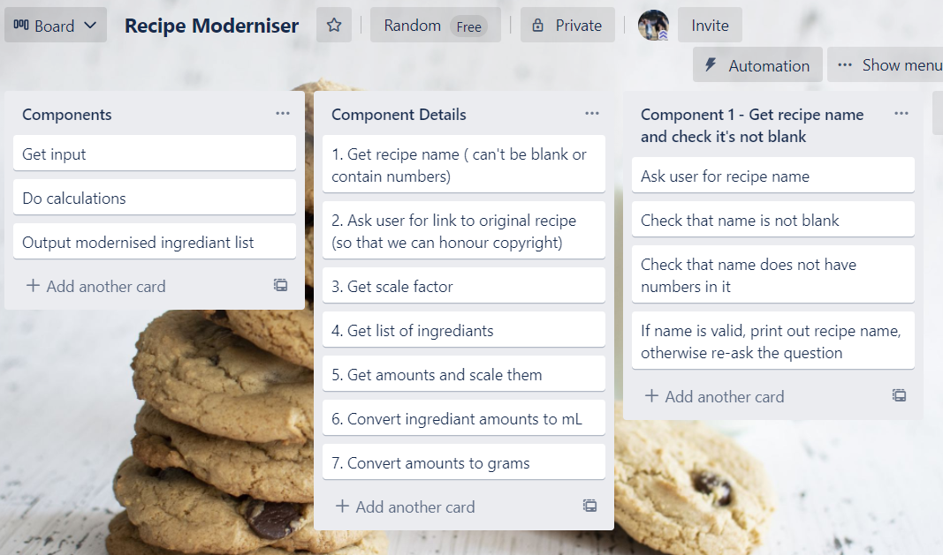
Decomposition:
Task Components:

Slide 5
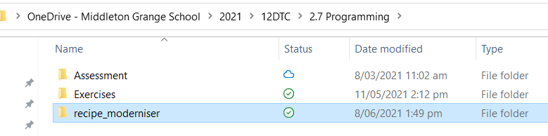
Version Control Evidence 1:
First I set up my logical folder structure in my OneDrive. This was so that I can have access to my files both at home and at school.
I called the project recipe_moderniser
Every component I create as part of this project will be saved in this folder.

Slide 6
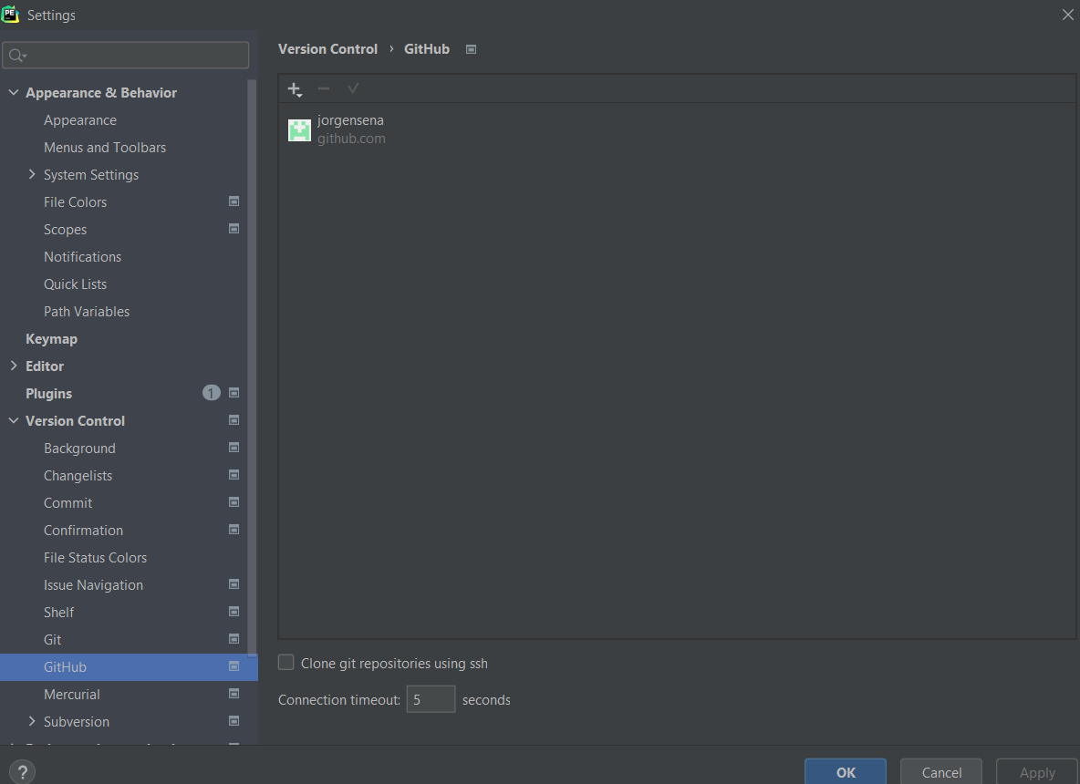
Version Control Evidence 2:
Then I set the version control for this project using GitHub. To do that I had to create a GitHub account and then set the version control properties in the Pycharm project to the GitHub account I had created.

Slide 7
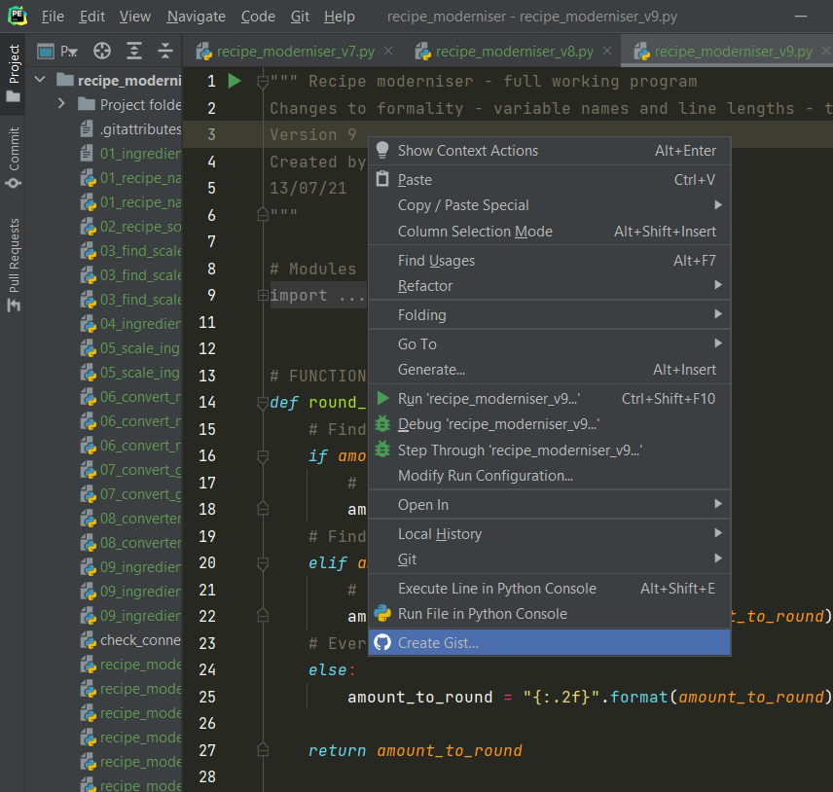
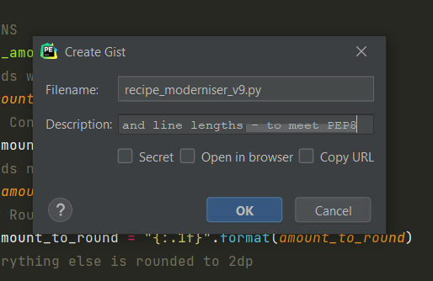
Version Control Evidence 3:
I created a new ‘Gist” in Pycharm for every component or sub-component. I was careful about the naming of my files – so they would be sequential. Each Gist includes a description of the code.

Slide 8
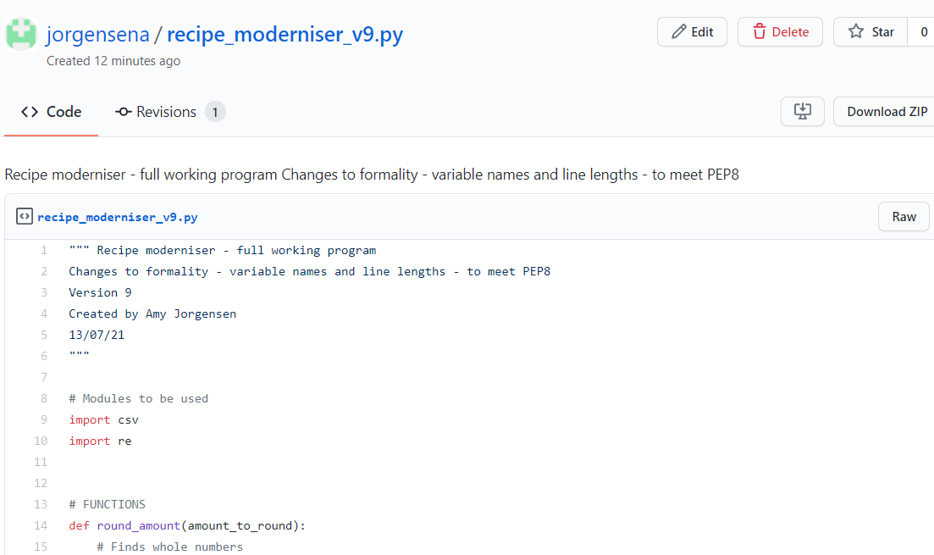
Version Control Evidence 4:
Managing my version control this way provided an efficient, clearly documented record of my progress and task completion. The repository also provided a complete backup of my project code at every stage. I was easily able to find my components to adapt and reuse throughout the project.

Slide 9
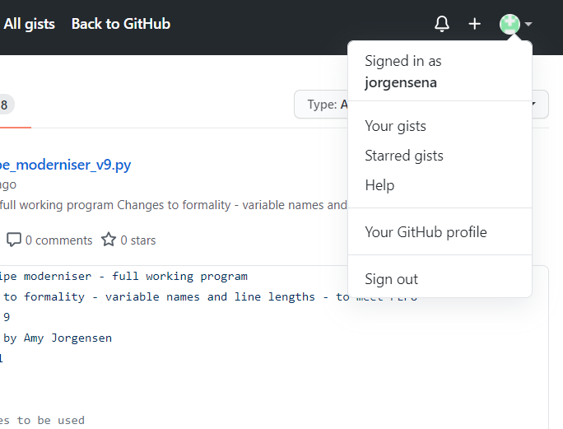
Version Control Evidence 5:
Getting back to my Gists, I log back into my GitHub account and then from the menu “Your Gists”
This is how I can go back and view previously uploaded Gists
Or I can access them here:
https://gist.github.com/jorgensena

Slide 10
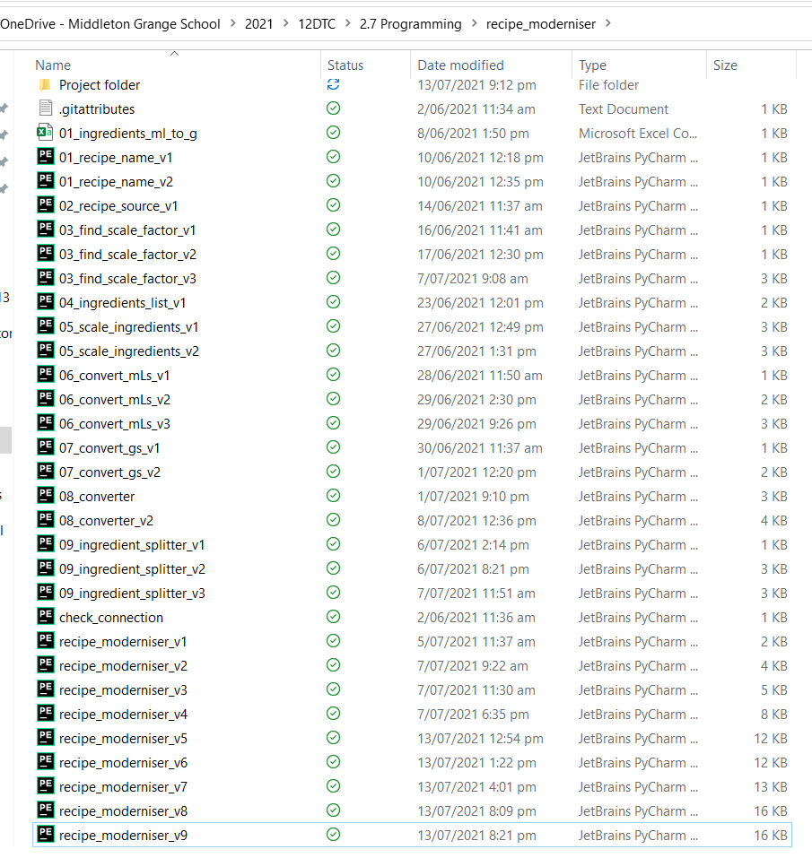
Version Control Evidence 5:
The image on the right is a screenshot of my project folder at the end showing all versions of all files.
During the project I also created a Gist each time I completed a component in the project
By the end of the project there were 34 Gists which can be viewed here:
https://gist.github.com/jorgensena
Components as they were constructed
Final outcome construction

Slide 11
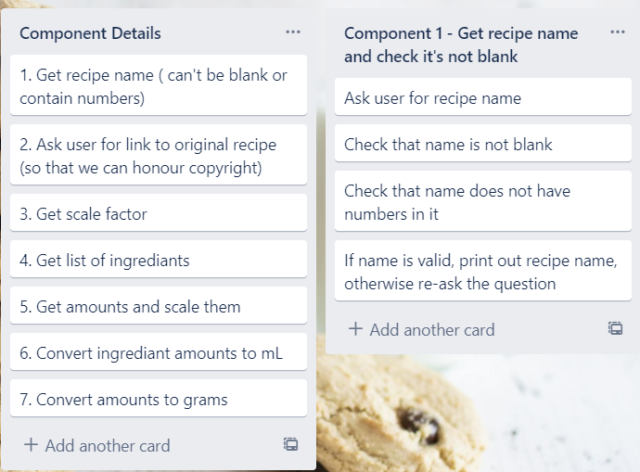
Component 1 (Trello screenshot)

Slide 12
Component 1 - Test Plan
Test Cases - input | Expected output
“Anzac Biscuits” | “You will be making Anzac biscuits”
“” < blank > | Error message
“anz4c” | Error message
This component will be developed as a function as the ingredient name can’t be blank either and I will be able to reuse the code. It is important that the program works as expected (functionality). We also want to make it easy to use. By preventing users from making mistakes like leaving the recipe name blank and checking that this works as expected. I am addressing both those implications.

Slide 13
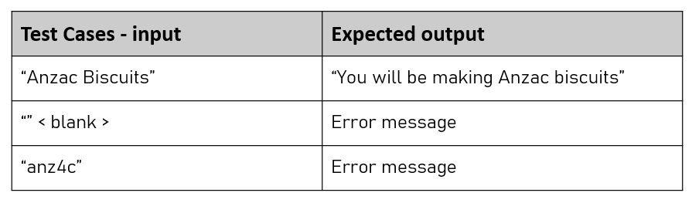
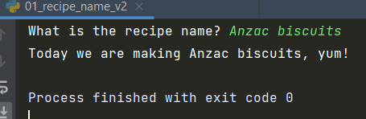
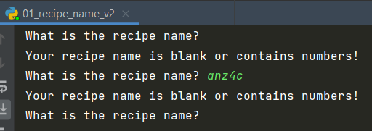
Component 1 – Screenshot of test

Slide 14
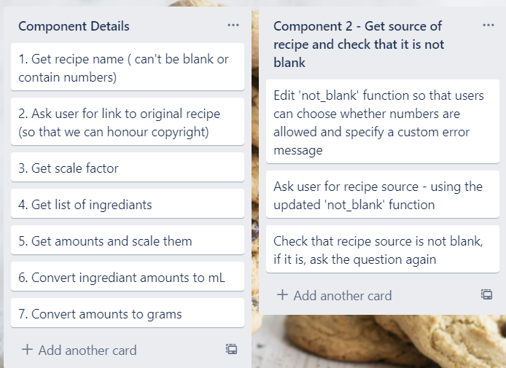
Component 2 (Trello screenshot)

Slide 15
Component 2 - Test Plan
Test Cases - input | Expected output
“” < blank > | Error message: “Please provide the original source/URL for the recipe”
https://edmondscooking.co.nz/recipes/biscuits/anzac-biscuits/ | “You have provided a valid source.” (i.e. The program will continue if the URL does not contain numbers)
https://www.allrecipes.com/recipe/278180/greek-yogurt-blueberry-lemon-pancakes/ | “You have provided a valid source.” (i.e. The program will continue if the URL does contain numbers)
This component will build on the previously created ‘not_blank’ function so that users can specify an error message and can also choose whether numbers are allowed in the response

Slide 16
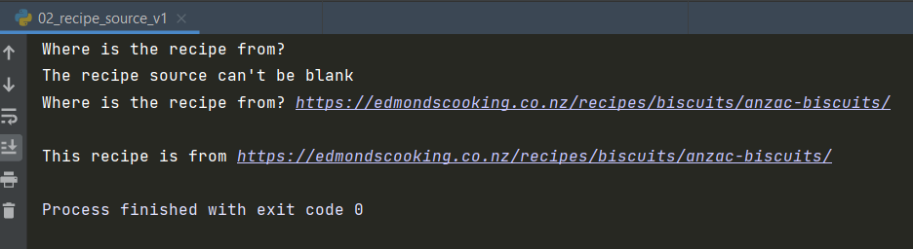
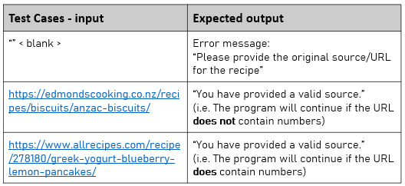
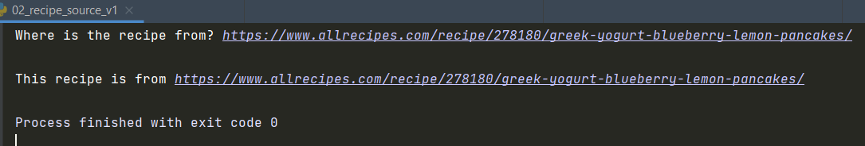
Component 2 – Screenshot of test

Slide 17
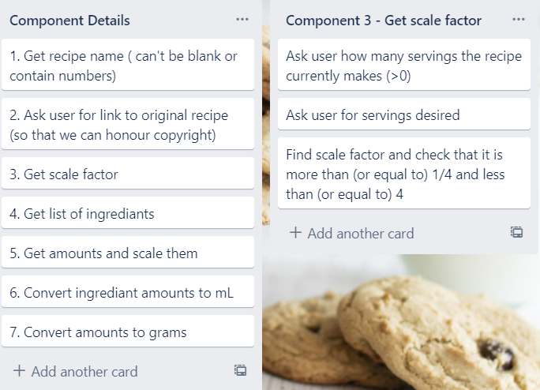
Component 3 (Trello screenshot)

Slide 18
Component 3 - Test Plan (servings_given)
Invalid/Boundary Input
Test Cases - input | Expected output
xiii | “Please enter a number”
0 | “Please enter a number that is more than 0”
0.1 | Program continues
Numeric input will be checked with a number checking function which can then be used to check recipe amounts are valid.

Slide 19
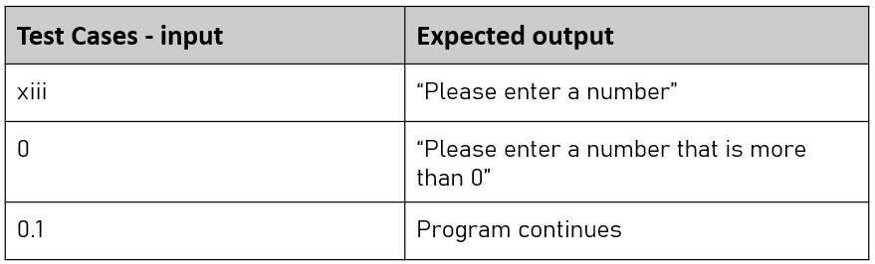
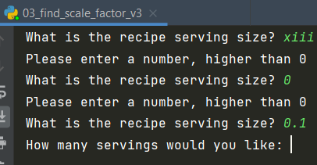
Component 3 - Test (servings_given)
Invalid/Boundary Input

Slide 20
Component 3 - Test Plan (servings_needed)
Invalid/Boundary Input
Test Cases - input | Expected output
xiii | “Please enter a number”
0 | “Please enter a number that is more than 0”
0.1 | Program continues
Numeric input will be checked with a number checking function which can then be used to check recipe amounts are valid.

Slide 21
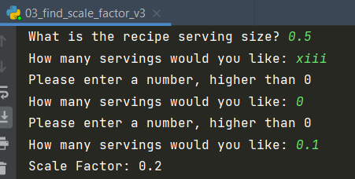
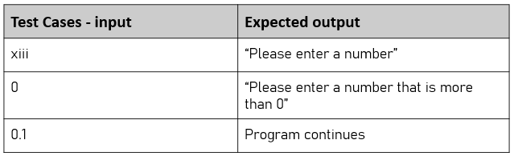
Component 3 - Test (servings_needed)
Invalid/Boundary Input

Slide 22
Component 3 - Test Plan (whole function)
Expected input – includes boundary testing
Test Cases - input | Expected output
How many servings does the recipe make? 4 Servings needed? 1 | Scale factor: 0.25
How many servings does the recipe make? 4 Servings needed? 16 | Scale factor: 4
How many servings does the recipe make? 5 Servings needed? 1 Change scale factor – Yes Servings needed? 2 | Scale factor: 0.2 Warning! This scale factor is very small and you might struggle to accurately weigh the ingredients. Please consider having more servings and freezing the left overs. Scale factor: 0.4
How many servings does the recipe make? 4 Servings needed? 17 Change scale factor – No | Scale factor: 4.25 Warning! This scale factor is quite large and you might struggle to fit everything in the bowl. Please consider having less servings and making more than one batch. Scale factor: 4.25

Slide 23
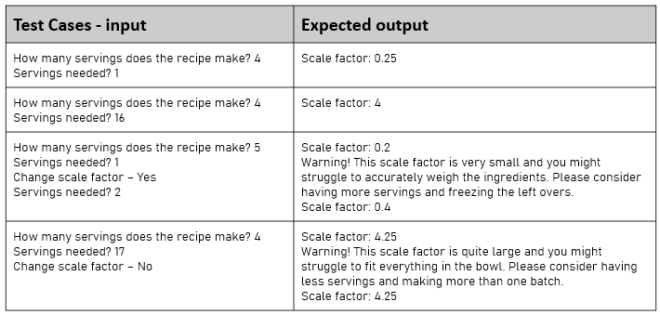
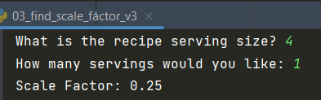
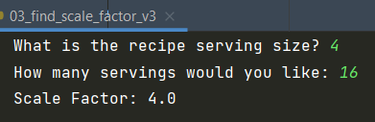
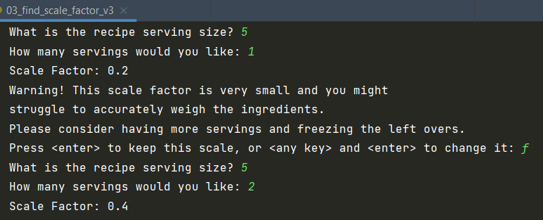
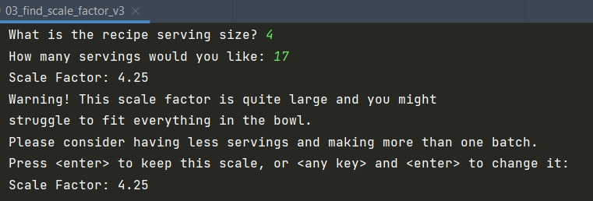
Component 3 - Test Plan (whole function)
Expected input – includes boundary testing

Slide 24
Relevant Implications – Component 3:
Discussing how the implications are being addressed in my program
Functionality: is about creating an outcome which works as intended. It is important that our recipe moderniser correctly calculates the scale factor to prevent the possibility of users wasting time and ingredients trying to follow an incorrect recipe. Testing that the scale factor has been correctly calculated is one way of addressing the ‘functionality’ implication.
Usability: is about how easy or intuitive a program is to use. Programs which are easy to use are more popular. The scaling feature of my program makes it easy for users to upsize or downsize quantities to match the number of servings needed. I have also addresses error correction/prevention and user freedom by building in warnings about the potential difficulties of working with very small or very large quantities but allowing the user to do it anyway.
Social: implications relate to how our outcome might affect society as a whole. I have opted for friendly, formal language in the wording of my error messages, making the outcome suitable for our intended audience (users aged 12 and up). The language is gender neutral and is easy to understand.

Slide 25
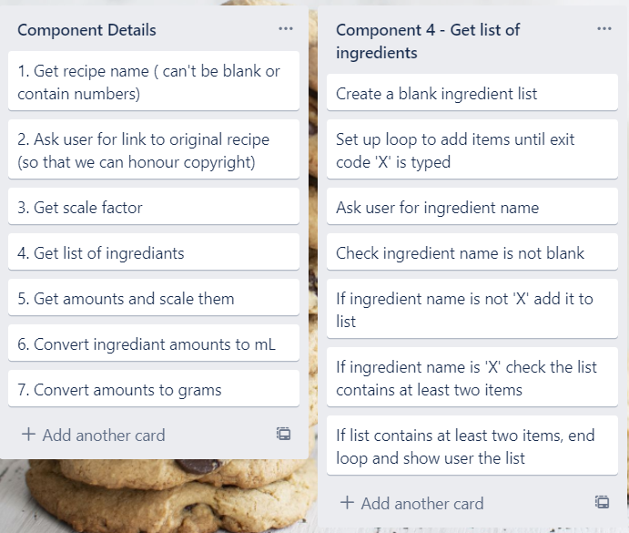
Component 4 (Trello screenshot)

Slide 26
Component 4 - Test Plan (list_of_ingredients)
Expected Input: this is text input so no test for invalid input
Test Cases - input | Expected output
Flour Eggs X | “Your ingredients: [‘Flour’, ‘Eggs’]”
<enter> Flour X | “Please enter an ingredient name (can’t be blank) Please enter at least two ingredients”

Slide 27
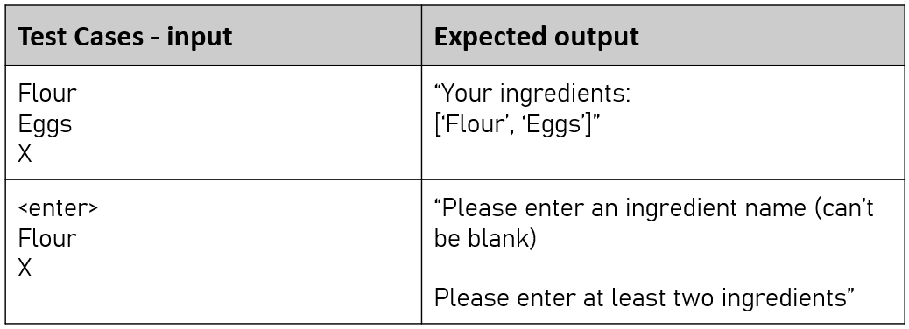
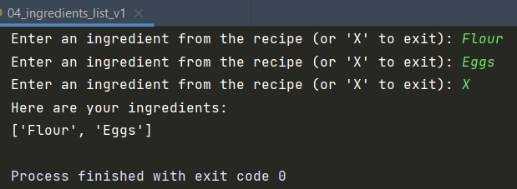
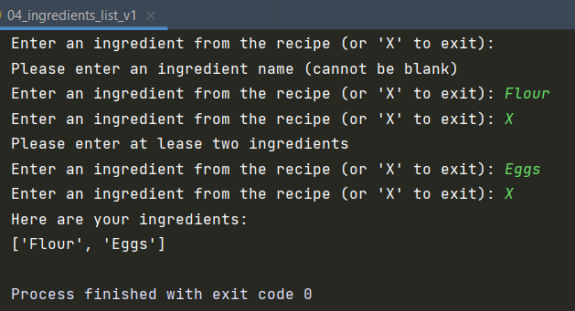
Component 4 - Test (list_of_ingredients)
Does not allow blank ingredient
Checks that recipe has more than 1 ingredient
Code works for expected values
Final list does not contain exit code

Slide 28
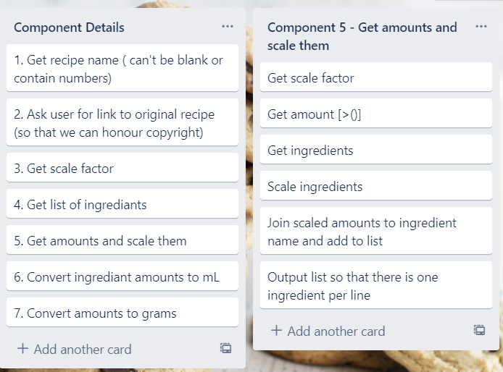
Component 5 (Trello screenshot)

Slide 29
Component 5 - Test Plan 1
Valid Input:
Test Cases - input | Expected output
Scale Factor = 2 1 Flour 3 Eggs x | << Note: will incorporate number checker later >> 2.0 units Flour 6.0 units Eggs

Slide 30
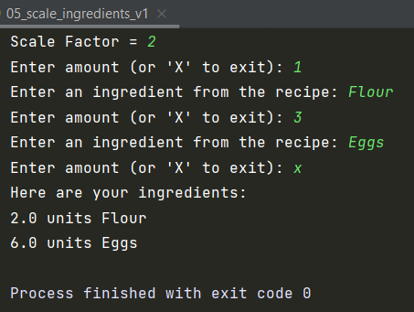
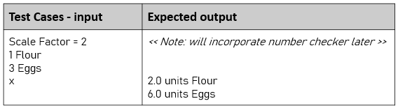
Component 5 – Test 1
Valid Input:

Slide 31
Component 5 - Test Plan 2
Invalid Input:
Test Cases - input | Expected output
Scale factor = 0.5 x 0 xiii 1 Flour 3 Eggs x | “Please enter at least two ingredients” “Please enter a number more than 0” “Please enter a number, higher than 0” 0.5 unit Flour 1.5 Eggs

Slide 32
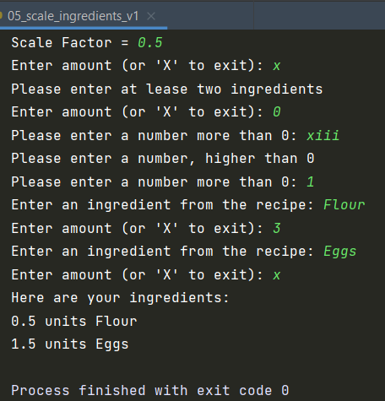
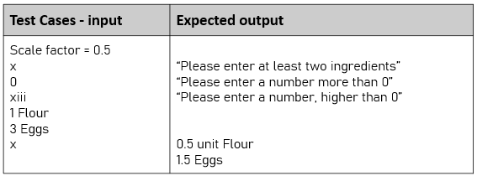
Component 5 – Test 2
Won’t allow less than 2 ingredients
Won’t allow zero quantities or invalid
Does allow ‘x’ to exit and produces list of scaled quantities with ingredients

Slide 33
Component 5 - Test Plan 3
Testing the formatting of numbers:
Test Cases - input | Expected output
Scale Factor = 1/4 4 Flour 2 Sugar 1 Butter x | 1 units Flour 0.5 units Sugar 0.25 units Butter

Slide 34
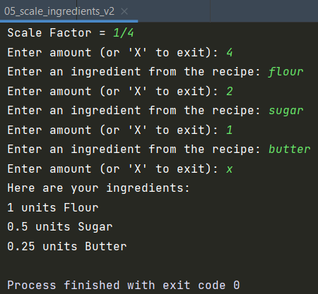
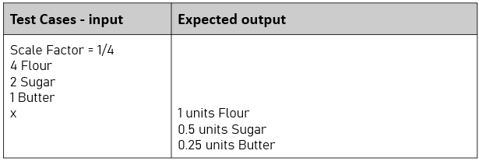
Component 5 – Test 3
Allows fractions
Extra testing shows nicely formatted units

Slide 35
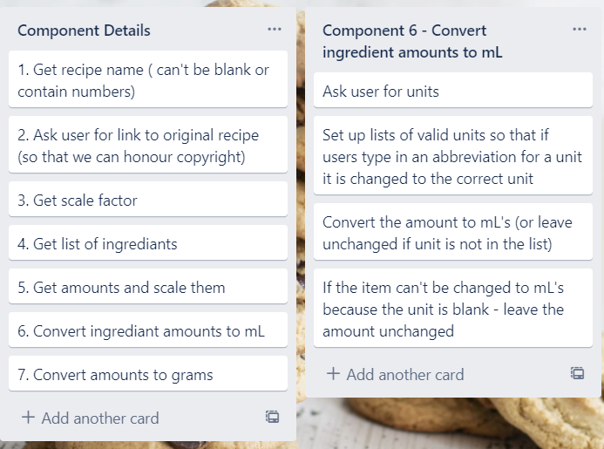
Component 6 (Trello screenshot)
Note: I will use my ‘not blank’ function to check the unit is not blank. This component will involve creating a function that get values from a dictionary and adjusts the amount of an ingredient.

Slide 36
Component 6 - Test Plan 1
Valid Input:
This test plan has been generated using a spreadsheet – to ensure the expected results have been calculated accurately. The conversion factor was supplied in the project documentation – 01_Recipe_Moderniser.docx (on p2).
This first test uses the full name of each unit:
Test Cases - Amount | Unit | Conversion (mL) | Result (mL)
4 | tsp | 5 | 20 | Expected result
3 | tbsp | 15 | 45
2 | cup | 237 | 474
3 | ounce | 28.35 | 85.05
1.5 | pint | 473 | 708.5
8 | foo (not in list) | 1 | 8 | Amount unchanged
0.5 | quart | 946 | 473
1.5 | pound | 454 | 681

Slide 37
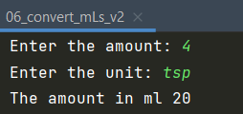
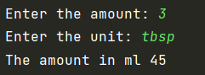
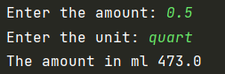
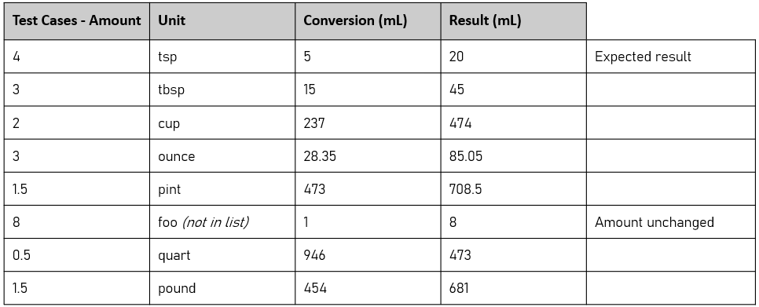
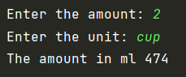
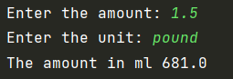
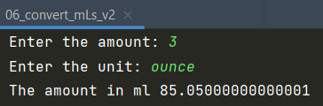
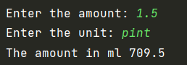
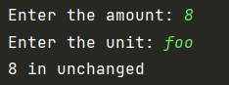
Component 6 – Test 1
Valid Input

Slide 38
Component 6 - Test Plan 2
Valid Input:
Once the basic calculator works. I need to ensure that common abbreviations will work, as well as their full names which we used in the first test.
I also need to check that if the unit is mL (which is not on the list) the amount does not change.
Test Cases - Amount | Unit | Conversion (mL) | Result (mL)
4 | t | 5 | 20 | Expected result
3 | T | 15 | 45
2 | c | 237 | 474
3 | oz | 28.35 | 85.05
1.5 | pt | 473 | 708.5
8 | ml (not in list) | 1 | 8 | Amount unchanged
0.5 | q | 946 | 473
1.5 | lb | 454 | 681

Slide 39
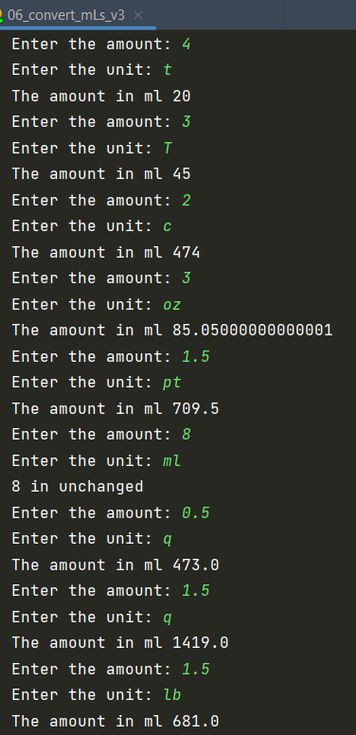
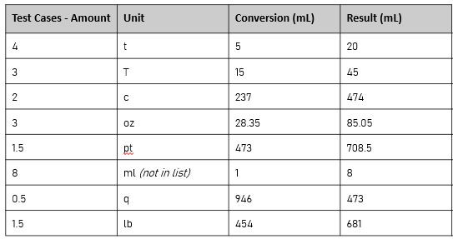
Component 6 – Test 2
Valid Input

Slide 40
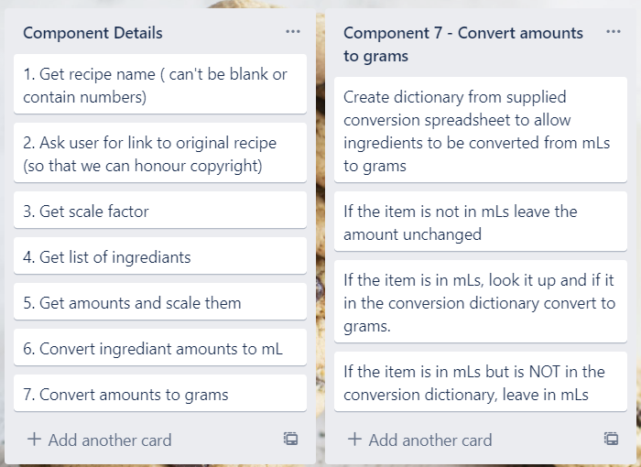
Component 7 (Trello screenshot)
Note: I will use my ‘not blank’ function to check the unit is not blank. This component will involve creating a function that get values from a dictionary and adjusts the amount of an ingredient.

Slide 41
Component 7 - Test Plan
Valid Input:
This takes an amount (mL) and converts it to grams using a conversion factor which is based on the number of grams in every 250mL of the ingredient – from the supplied spreadsheet 01_ingredient_ml_to_g.csv. The conversion factor is simply the number e.g. 258/250
Amount | Unit | Mass (g) of 250mL (cup) | Conversion (mL → g) | Result (g)
50 | MILK | 258 | 1.032 | 51.6
15 | vinegar | 243 | 0.972 | 14.58
237 | all purpose flour | 127 | 0.508 | 120.396
5 | Baking Powder | 200 | 0.800 | 4
5 | basil | n/a | n/a | 5mL (unchanged)

Slide 42


Component 7 – Test
Valid Input

Slide 43


Component 8 – conversion function (extra refinement)
Below is a key part of the code for component 6 (checking measurements and converting to mL) and component 7 (converting mLs to grams). Although the dictionaries being used are different, and dividing by 250 when converting to grams, I decided to develop a function to remove the repeated code to make it more efficient. This will also make it easier when I come to combining my component for the full program.
Component 6 | Component 7

Slide 44
Component 8 - Test Plan
Valid Input:
Testing that the new conversion (to mL) function still works on expected units:
Amount | Unit | Conversion (mL → g) | Result (g)
4 | tsp | 5 | 20
3 | tbsp | 15 | 45
2 | cup | 237 | 474
3 | ounce | 28.35 | 85.05
1.5 | pt | 473 | 709.5
8 | ml | 1 | 8
0.5 | q | 946 | 473
1.5 | lb | 454 | 681

Slide 45


Component 8 – Test
Valid Input

Slide 46

Assembled Outcome – Trello plan
This is how I plan to link the components together into a finished working program.
The pink labelled list shows the loop needed for each ingredient. This plan forms the basis for the ‘To Do’ list in PyCharm.

Slide 47
Assembled Outcome v1: Test plan 1
recipe_name – can’t include digits or be left blank
Test Cases - input | Expected output
4nzaC bikkies | The recipe name can’t be blank, or contain numbers!
“” <enter> | The recipe name can’t be blank, or contain numbers!
Anzac Biscuits | The recipe is for Anzac Biscuits

Slide 48


Assembled Outcome v1: Test 1
recipe_name – can’t include digits or be left blank

Slide 49
Assembled Outcome v1: Test plan 2
recipe_source – can’t be left blank but digits are okay
Test Cases - input | Expected output
“” <enter> | The recipe source can’t be blank!
https://edmondscooking.co.nz/recipes/biscuits/anzac-biscuits/ | The recipe is from https://edmondscooking.co.nz/recipes/biscuits/anzac-biscuits/
https://www.allrecipes.com/recipe/278180/greek-yogurt-blueberry-lemon-pancakes/ | The recipe is from https://www.allrecipes.com/recipe/278180/greek-yogurt-blueberry-lemon-pancakes/

Slide 50



Assembled Outcome v1: Test 2
recipe_source – can’t be left blank but digits are okay

Slide 51
Component 9 – ingredient splitter function (extra refinement)
Entering ingredients using three steps (amount, unit and ingredient name) is not as easy as typing it as one line (or copy/pasting a line from a recipe). To enable our user to enter the ingredients as one line our program needs to be able to split the input into amount, unit and name. Here are some typical inputs sourced from various recipes.
Test cases | Amount | Unit | Ingredient
¾ cup milk (fraction of a cup) | 0.75 | cup | milk
1 cup flour (normal cup) | 1 | cup | flour
2 tablespoons white sugar (unit has extra s, and ingredient has space in name) | 2 | tbls | white sugar
1 ¾ cups flour (mixed fraction, unit has extra s) | 1.75 | cup | flour
1.5 tsp baking powder (decimal amount, ingredient has space in name) | 1.5 | tsp | baking powder
pinch cinnamon | <blank> | pinch | cinnamon

Slide 52



Component 9 – ingredient splitter function (extra refinement)
Valid Input: Shows quantities being successfully extracted and evaluated as numbers
Original Recipe
Numbers successfully extracted and evaluated. Output has been concatenated into a readable list. Plurals (e.g. cup vs cups) to be resolved later

Slide 53
Assembled Outcome v2: Test plan
After incorporating scale factor component – testing to make sure it scales both up and down
Input | Expected Output
Serving size: 1 Servings needed: 3 | 3.0
Serving size: 12 Servings needed: 6 | 0.5
Serving size: 1 Servings needed: 5 | 5.0 “Too large “ warning
Serving size: 5 Servings needed: 1 | 0.2 “Too small” warning
blank 0 v 2 | “Enter a number greater than 0” (for each)

Slide 54




Assembled Outcome v2: Test (a)
After incorporating scale factor component – testing to make sure it scales both up and down
Scales up
Scales down
Warns user if the outcome will be too large

Slide 55


Assembled Outcome v2: Test (b)
Warns user is the outcome will mean working with tiny quantities
After incorporating scale factor component – testing to make sure it scales both up and down
Won’t accept blank, 0 or invalid serving size
Won’t accept blank, 0 or invalid servings required

Slide 56
Assembled Outcome v3: Test plan
Initial testing when component 4 is added to the final outcome – adding ingredients
Input | Expected Output
<enter> | “Cannot be left blank and quantity must be more than 0)
3 eggs | “Enter ingredient on one line – quantity, unit, then name (or ‘X’ to exit):
0 cups flour | “Cannot be left blank and quantity must be more than 0)
½ cup flour | “Enter ingredient on one line – quantity, unit, then name (or ‘X’ to exit):
X | [‘3 Eggs’, ‘1/2 cup flour’]

Slide 57


Assembled Outcome v3: Test
Initial testing when component 4 is added to the final outcome – adding ingredients
There is a problem with it accepting 0 qty (e.g. 0 cups flour above). I need to fix this in the next version

Slide 58
Assembled Outcome v4: Test plan
Initial testing when component 9 is added to the final outcome – adding ingredients
Input | Expected Output
Serving size: 2 Servings needed: 4 | Enter an ingredient – quantity, unit, then name (or ‘x’ to exit):
1 ½ cups flour | 3 Cups Flour
¼ cup cocoa | 0.5 Cups Cocoa
3 tsp baking powder | 6 Tsp Baking Powder
2 eggs | 4 Eggs
Pinch of salt | Pinch of Salt

Slide 59


Assembled Outcome v4: Test
Initial testing when component 9 is added to the final outcome – adding ingredients
Showing scale factor of 2 - double ingredients
Scaled all items by a factor of 2 except pinch of salt

Slide 60
Component 8 v2 - Test Plan
Valid Input:
This takes an amount (ml) and converts it to grams using a conversion factor which is based on the number of grams in every 250ml of the ingredient – from the supplied spreadsheet 01_ingredients_ml_to_g.csv. The conversion factor is simply the number e.g. 258 / 250
Amount (mL) | Unit | Mass (g) of 250mL (cup) | Conversion (mL → g) | Result (g)
50 | MILK | 258 | 1.032 | 51.6
15 | vinegar | 243 | 0.972 | 14.58
237 | all purpose flour | 127 | 0.508 | 120.396
5 | Baking Powder | 200 | 0.800 | 4
5 | basil | n/a | n/a | 5mL (unchanged)

Slide 61


Component 8 v2 - Test
Valid Input:
Working as expected

Slide 62
Assembled Outcome v5: Test plan
Having added components 7 and 8
Input (amount) | Input (unit) | Input (ingredient) | Decimal | Scale Factor | Multiplier | Grams per 250 mL (from ingredient.csv) | Conversion Factor (A/250) | mL (from unit dict) | Expected Output (grams)
½ | cup | flour | 0.5 | 2 | 1 | 127 | 0.508 | 237 | 120.396
1/3 | cup | sugar | 0.3333 | 2 | 0.6666 | 200 | 0.8 | 237 | 126.3874
¾ | cup | rolled oats | 0.75 | 2 | 1.5 | 90 | 0.36 | 237 | 127.98
50 | g | butter | 50 | 2 | 1 |  |  |  | 100
1 | Tbsp | golden syrup | 1 | 2 | 2 | 350 | 1.4 | 15 | 42
½ | tsp | baking powder | 0.5 | 2 | 1 | 200 | 0.8 | 5 | 4
2 | Tbsp | water | 2 | 2 | 4 | 250 | 1 | 15 | 60

Slide 63


Assembled Outcome v5: Test
After having added components 7 and 8
Met tests as expected, although the result is not well laid out and the number should be rounded. These will be addressed in the next version

Slide 64
Assembled Outcome v5: Test
Testing readability and layout
Although the program meets the basic requirements, it’s layout and readability could be improved with better spacing.
Also the recipe name and source are not displayed in the output.
This will be addressed in the next version because the current format would be of limited value to end-users

Slide 65


Assembled Outcome v6: Test plan
Checking that expected inputs are converted and scaled appropriately and improving readability

Slide 66



Assembled Outcome v6: Test
Checking that expected inputs are converted and scaled appropriately and improving readability
Numbers need to be rounded to 0dp
Spacing and readability have been improved. Recipe name and source of recipe are now clearly included at the top of the output
Numbers need to be rounded – to numbers which are relevant to the user – no decimal places are required

Slide 67

Assembled Outcome v7: Test – using v6 test plan
Tidied up the output to make it easier for the user
Input area neatly laid out.
Ingredient input statement kept to one line.
Line numbering has been used to make it easier for the user to enter each ingredient
Added spacing to break up the sections and aid readability
Numeric output has been rounded to eliminate impractical fractional amounts

Slide 68
Usability Testing
Ask a volunteer to use your program and observe them doing so. Write a list of improvements which need to be made based on your usability testing. Then make the required changes.
Mr Baker’s mum:
Entered an Afghan recipe (see next page) and discovered a couple problems that I need to fix:
Problems:
Put an introduction at the start which explains how to use the program
Make it clear that fractions can be used (e.g. write ‘half’ as ‘1/2’)
Suggest serving size of ‘1’ if user doesn’t know what the serving size is
Edit the number checking function so that it accepts fractions – for serving sizes
Add lb. and oz. (i.e. full stop after abbreviations for pounds and ounces from older recipes)

Slide 69


Usability Testing
Won’t accept fractional amounts to be entered
No introduction at the start telling the user what to do

Slide 70
Post Usability Testing
Show that, having made the required changes from your usability testing, your program works correctly
As a result of my usability testing, I made the changes below:
Added optional instructions for the user if they say this is their first time using the program. The instructions explain that they can use fractions and tells them what to write for a serving size if they are unsure.
Fixed the number checker so that if the user enter a fraction for the serving size the program still works correctly.
Updated the abbreviations list to include lbs. and oz. (full stops at the end of the abbreviations – found in some older recipe books)
Ensured the program won’t crash if user make a mistake when entering fractions in the recipe line e.g. 1/ instead of 1/4. If this happens the program will continue but the user will be warned that some of the recipe lines could not be processed.

Slide 71

Post Usability Testing 2
Errors in the input – both lines
Program working correctly in spite of invalid numeric input on recipe line
Warning given that some entry data was invalid
Prints the invalid data without crashing

Slide 72
Post Usability Testing 3
Name | Post Usability Testing |  | First Time User = True
Source | Test
Servings given | 1
Servings needed | ½
Scale factor | 0.5
Amount | Unit | Ingredient | Output (with WARNING)
0.5 | cup | flour | 30 g flour
1 | tsp | water | 2 ml water
0.5 | tsp | water | 1 ml water
1/ | cup | foo | 1/ cup foo
First time user – instructions provided
Program working correctly, in spite of invalid numeric input on recipe line

Slide 73


Post Usability Testing 4
First time user – instructions provided
Program working correctly, in spite of invalid numeric input on recipe line
<enter> pressed
Instructions printed
Error in numeric entry does not cause program to crash but produces the warning message

Slide 74


Post Usability Testing 5
Entered ‘x’ to bypass instructions but otherwise the program ran exactly as expected
Instructions not required – user entered an ‘x’ to bypass instructions

Slide 75
Relevant Implications:
Discuss how the implications have been addressed in your code
Functionality | The program components were all thoroughly tested, idividually, during construction. They were again retested after they had been combined into the finished program to ensure the program functions exactly as intended. Functionality is important as the final program needs to work as expected. It should correctly convert ingredients to grams / mLs and also accurately scal the recipe if desired. If the program does not not work correctly, then users would become frustrated is baking made based on the modernised recipies would not be of an acceptable standard. I have ensured that my outcome functions as intended by testing each component and then testing the assembled outcome to ensure that the conversions are correct and that the program does not crash if unexpected input is entered.
Future Proofing | The code is well set out and clearly commented so that another programmer can understand my logic and easily make changes at some future time. Variable names are succinct but descriptive. Functions are used so that code is not repeated unnecessarily, dictionaries are used so more information can be added in the future if more ways of writing a unit are found.

Slide 76
Relevant Implications:
Discuss how the implications have been addressed in your code
Usability | The program is suitable for a wide audience as it is easy to understand and use. No technical knowledge is required because all instructions are clearly and succinctly spelled out at each stage. The program was tested for usability with the help of a volunteer and many improvements were made based on feedback received during that process. User inputs have been constructed in a way that makes is difficult to make the program crash, even when the user enter unexpected or invalid data. Usability involves insuring that the program is easy to use, There are a number of elements involved in creating an outcome that is easy to use and these include user freedom, flexibility, error prevention and control, and help and documentation. My program allows users to enter amounts as fractions or ‘normal’ numbers. It also copes with a wide range of potential units and errors.

Slide 77
Final Discussion:
Discuss how the information from planning, testing and trialling of components assisted in the development of a high-quality outcome.
I planned to create a ‘Recipe Moderniser’ program using Python. The program meets my objective of making it easy to convert historic measures such as cups, teaspoons, and tablespoons into grams and millilitres. It also enables the user to easily scale required quantities up or down.
To do this I followed the process, I planned, tested and trialled its individual components and then later as a whole working program
By decomposing the problem, I was able to plan my program efficiently and was able to focus on creating and testing small components of code. Each of these components was thoroughly tested during and after construction

Slide 78
Final Discussion:
Discuss how the information from planning, testing and trialling of components assisted in the development of a high-quality outcome.
By testing I was able to find and fic the flaws in my program before combining them into the full program
Having a volunteer (Mr Baker’s mum) test my program enabled me to further improve it’s functionality and get ideas about how to make it better which raised the reliability and quality of the finished program.
User feedback enabled me to look at the program from a non-programmer’s point of view. This, combined with the information I got from the earlier planning, testing, and trialling enabled me to produce a high-quality outcome.
I tested my code using http://pep8online.com/ to make sure that it met the conventions regarding spacing and layout – see on next page

Slide 79

Final Discussion:
I checked that my code met the PEP8 standards using http://pep8online.com/

